Slide 1
Darussalaam welfare centre
Strategy & Overview

Slide 2
Objective
To provide a final resting place for community members to ensure that everyone, regardless of their financial situation, has a dignified place for burial.
This can include:
  Offering affordable burial services to alleviate the financial burden of grieving families
  Ensuring the needs of any religious or cultural groups are met respectfully

Slide 3
Vision & Mission
VISION
A harmonious, inclusive, equitable and poverty free society that respects human dignity from cradle to grave
MISSION
Advance social and public welfare by providing relief from poverty, helplessness and distress, especially related to funeral and burial costs
Promote health by preventing mental health deterioration due to financial distress related to burial and funeral services
Promote reconciliation, mutual respect and tolerance by providing subsidised burial and funeral services to financially disadvantaged families from all backgrounds regardless of their culture, ethnicity or religious beliefs
Foster positive social relationships between Muslims and non-Muslims by encouraging and assisting Muslims to integrate into Australian society

Slide 4
CORE SERVICE
Provide resting place for burial
Collection of body for funeral services
  Washing service for Muslim burials
  Shrouding
  Funeral prayer
  Burial

Slide 5
STRATEGY
Community awareness through townhall and place of worship.
Raise funds through donations and gifts.
Prepare cemetery in Wollondilly Shire.
Procure necessary equipments and materials to operate funeral services.
Identify and employ necessary personnels.

Slide 6
TARGET CLIENTS
Financially disadvantaged Muslims and First Nations people.
Newly reverted Muslims, refugees, people on temporary visas will be prioritised.

Slide 7

Customer journey
Customer Referral
Burial of person
Application Review – Advisory Board
Communicate program to family impacted and their point of contact
Credit Matrix Assessment
Funeral arrangements in place
Application
Funeral Service Support
Burial Support
Impact Reporting
Ensure burial spot allocated
Report results and impact of program to stakeholders and community
Funeral Director allocated

Slide 8
Credit risk assessment
Low income candidates will be considered for the program as recommended by community organisations. Selection will be based on likelihood of client not having immediate financial support for funeral arrangement and any collateral they may own in.
Severity
 | Acceptable Have no assets | Tolerable Have some assets | Intolerable Have large assets
Probable Highly unlikely to have finance for burial | Low
Possible Highly unlikely to have finance for burial |  | Medium
Probable Highly likely to have finance for burial |  |  | High
Likelihood
Risk Rating Key | Low Ok to proceed | Medium Ok to proceed, take mitigation efforts | High Cannot proceed

Slide 9
BUSINESS MODEL

Slide 10
REVENUE STREAM & key expenses
Funds will be raised mainly through donations and gifts.
Key expenses initially will be land purchase and costs associated with it and in later years will be admin cost required to maintain land and run the organisation.

Slide 11
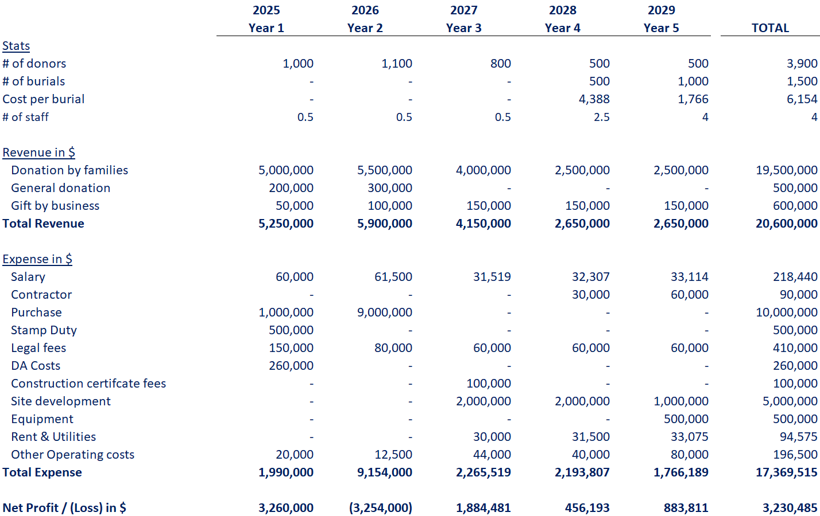
PROJECTED P&L – 5 Year plan

Slide 12
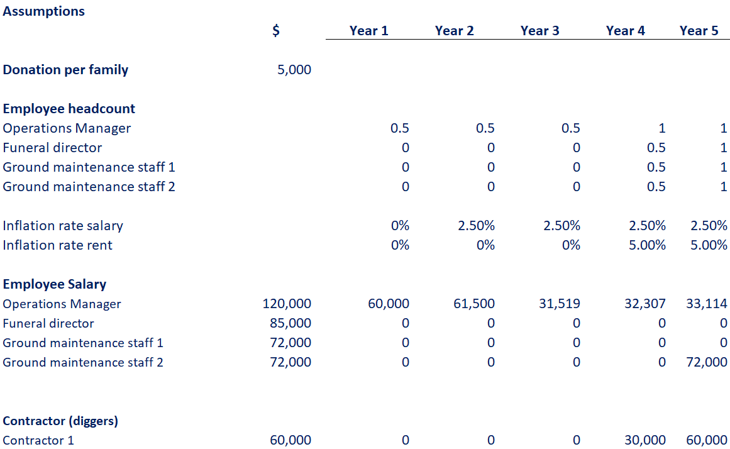
PROJECTED P&L – cost Assumptions

Slide 13
NEXT STEPS

Slide 14
5 year business plan
Receive fund through gifts and donations
2024-2026: Purchase a parcel of land for establishing a multi-denominal cemetery; prepare DA application
2027-2029: Site development

